Slide 1
Spring Data

Slide 2
What is Spring Data?
Spring Data is an umbrella project, not a single component. It's a collection of modules, each focusing on a different aspect of data access or a specific type of data store.
Features
Powerful repository and custom object-mapping abstractions
Dynamic query derivation from repository method names
Implementation domain base classes providing basic properties
Support for transparent auditing (created, last changed)
Possibility to integrate custom repository code
Easy Spring integration via JavaConfig and custom XML namespaces
Advanced integration with Spring MVC controllers
Experimental support for cross-store persistence

Slide 3
Main modules
Spring Data Commons - Core Spring concepts underpinning every Spring Data module.
Spring Data JDBC - Spring Data repository support for JDBC.
Spring Data R2DBC - Spring Data repository support for R2DBC.
Spring Data JPA - Spring Data repository support for JPA.
Spring Data KeyValue - Map based repositories and SPIs to easily build a Spring Data module for key-value stores.
Spring Data LDAP - Spring Data repository support for Spring LDAP.
Spring Data MongoDB - Spring based, object-document support and repositories for MongoDB.
Spring Data Redis - Easy configuration and access to Redis from Spring applications.
Spring Data REST - Exports Spring Data repositories as hypermedia-driven RESTful resources.
Spring Data for Apache Cassandra - Easy configuration and access to Apache Cassandra or large scale, highly available, data oriented Spring applications.
Spring Data for Apache Geode - Easy configuration and access to Apache Geode for highly consistent, low latency, data oriented Spring applications.

Slide 4
Spring Data JPA

Slide 5
Objectives
What is Spring Data?
What is Spring Data JPA?
Core Concepts
Repository Interface
Query Methods
JPQL and Native Queries
Spring Data JPA with Spring Boot
Benefits and Best Practices

Slide 6

What is Spring Data JPA ?
Spring Data JPA is a part of the Spring Framework that simplifies the development of data access layers for Java applications, specifically those using JPA (Java Persistence API). It provides a higher-level abstraction over JPA, allowing developers to interact with databases using simpler and more expressive methods.

Slide 7
Key Features of Spring Data JPA
Repository Abstraction: It introduces the Repository interface, which defines common data access methods like save, find, delete, etc. Spring Data JPA automatically generates implementations for these methods based on method names and domain class conventions.
Spring Data JPA Repositories: You create custom repositories by extending the Repository interface and defining custom query methods. Spring Data JPA uses a naming convention to automatically generate query implementations.
Query Annotation: You can use the @Query annotation to write custom JPQL or native SQL queries.
Specification API: You can create dynamic query criteria using the Specification API, allowing for complex filtering and sorting.
Integration with Spring Framework: It seamlessly integrates with other Spring components like Spring MVC, Spring Security, and Spring Boot.

Slide 8
Benefits of using Spring Data JPA
Reduced Boilerplate Code: It significantly reduces the amount of code you need to write for data access operations.
Improved Productivity: By simplifying data access, it increases developer productivity.
Enhanced Maintainability: The code becomes more maintainable due to its simplicity and adherence to conventions.
Flexibility: It supports various database systems through JPA and provides options for custom query methods and specifications.
Strong Community and Support: It benefits from the large Spring community and has extensive documentation and support resources.

Slide 9
Core Concepts of Spring Data JPA

Slide 10
Spring Data JPA Annotations
@Entity: Marks a class as a JPA entity, indicating that it represents a database table.
@Table: Specifies the name of the database table to which the entity is mapped.
@Id: Marks a field as the primary key of the entity.
@GeneratedValue: Specifies the strategy for generating primary key values (e.g., GenerationType.IDENTITY, GenerationType.AUTO, GenerationType.SEQUENCE, GenerationType.TABLE).
@Column: Configures column-specific properties like name, length, nullable, and unique constraints.

Slide 11
Relationship Mapping Annotations
@OneToOne: Defines a one-to-one relationship between two entities.
@OneToMany: Defines a one-to-many relationship between two entities.
@ManyToOne: Defines a many-to-one relationship between two entities.
@ManyToMany: Defines a many-to-many relationship between two entities.
@JoinColumn: Specifies the foreign key column in the database table

Slide 12
Query Annotations
@Query: Defines a custom JPQL or native SQL query.
@Modifying: Indicates that a query modifies data.
@Param: Binds a parameter to a query.
Other Annotations
@Temporal: Specifies the temporal type of a field. (e.g., TemporalType.DATE,TemporalType.TIME,TemporalType.TIMESTAMP)
@Enumerated: Specifies the enumeration type for a field.
@Lob: Maps large object types (e.g., CLOB, BLOB).
@Transient: Excludes a field from persistence.
@Version: Specifies a version field for optimistic locking.

Slide 13
JPA Query Methods

Slide 14
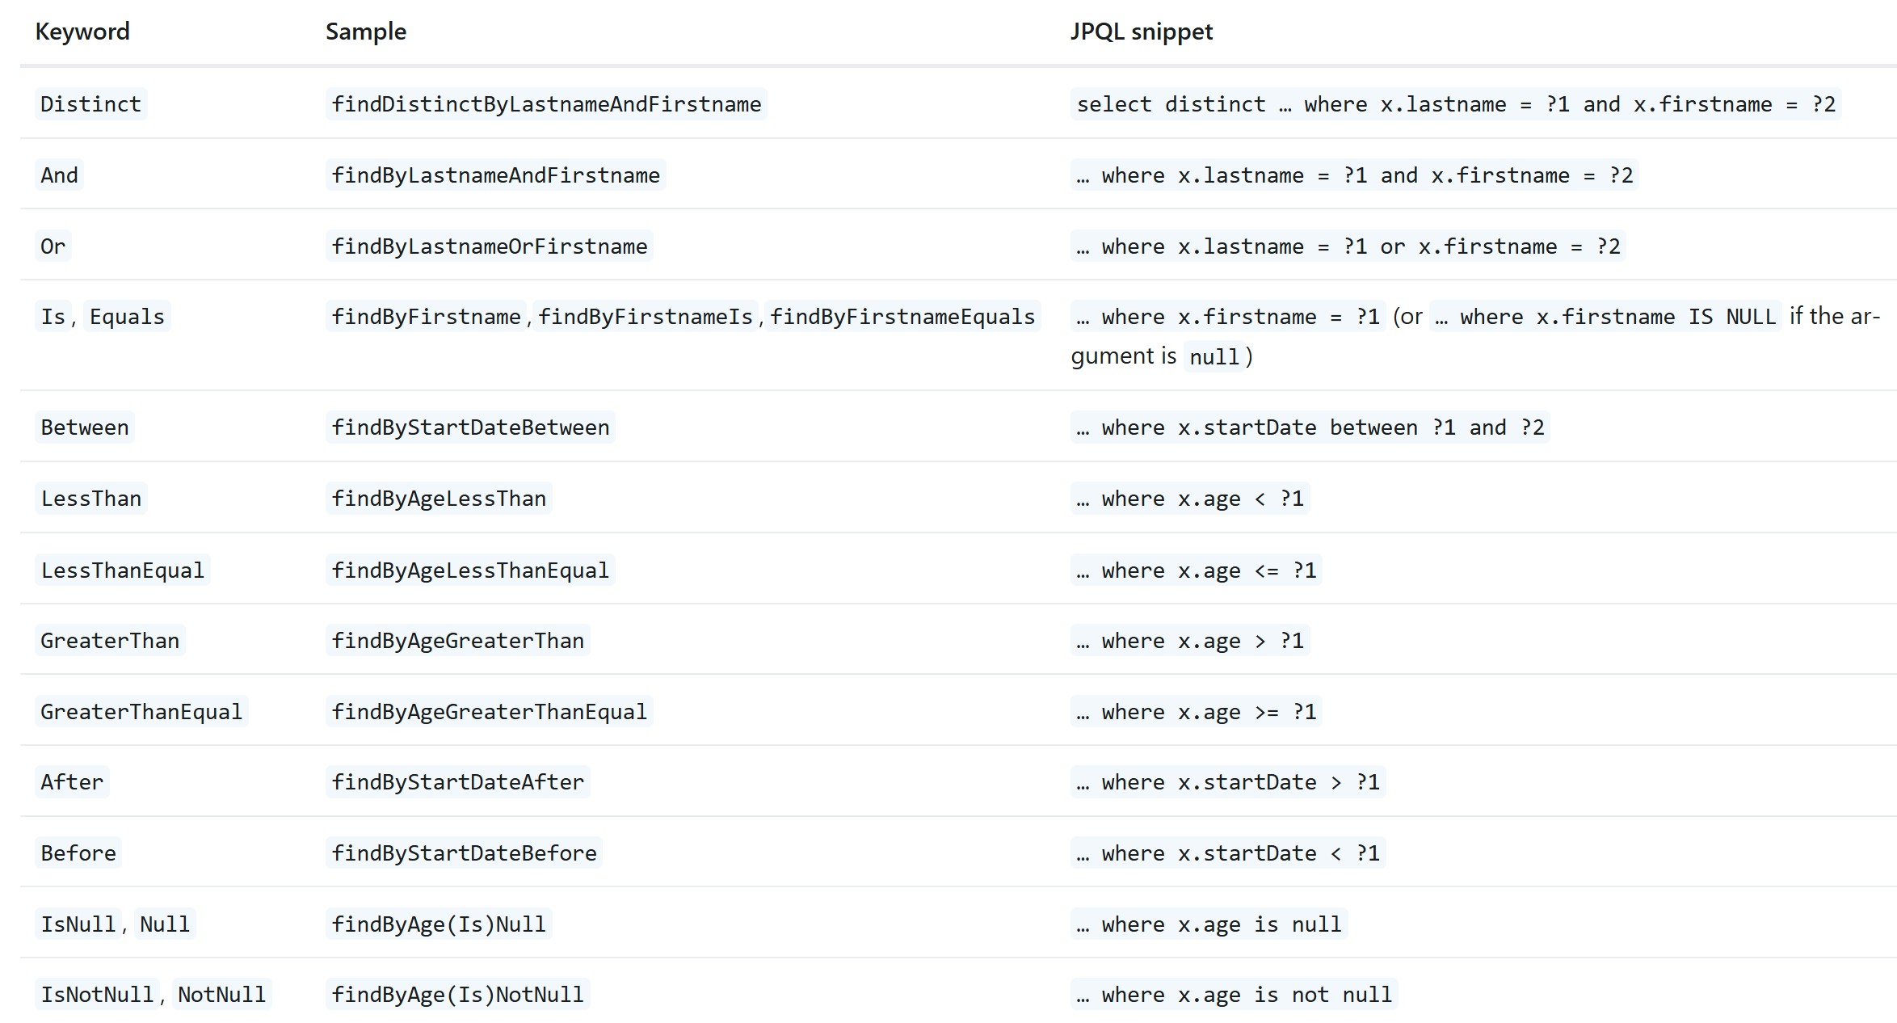
JPA Query
https://docs.spring.io/spring-data/jpa/reference/jpa/query-methods.html

Slide 15
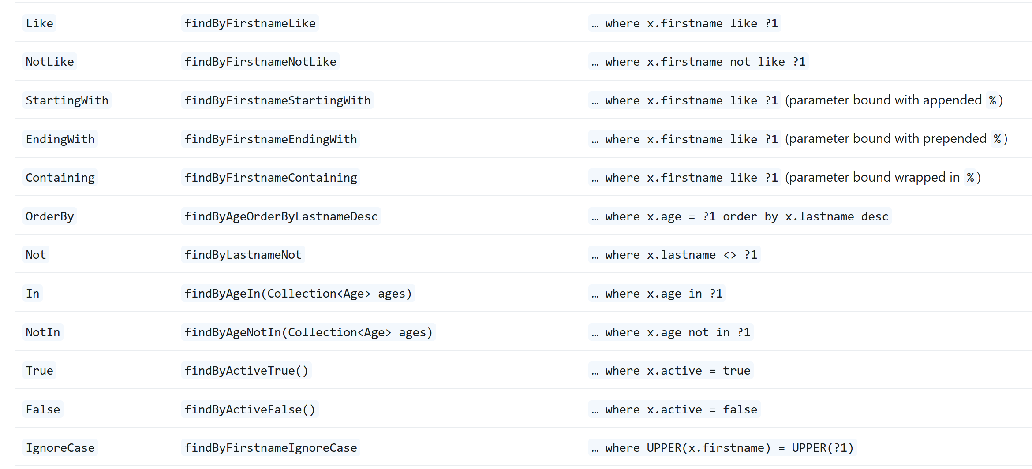
JPA Query
https://docs.spring.io/spring-data/jpa/reference/jpa/query-methods.html

Slide 16
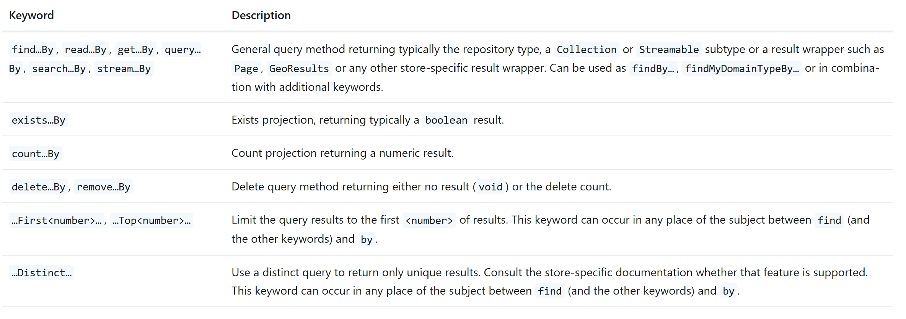
Repository query keywords
https://docs.spring.io/spring-data/jpa/reference/repositories/query-keywords-reference.html

Slide 17
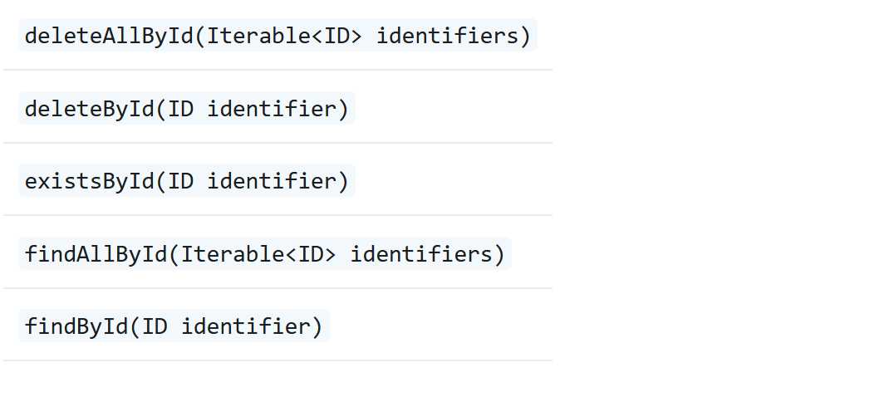
Reserved methods
https://docs.spring.io/spring-data/jpa/reference/repositories/query-keywords-reference.html

Slide 18
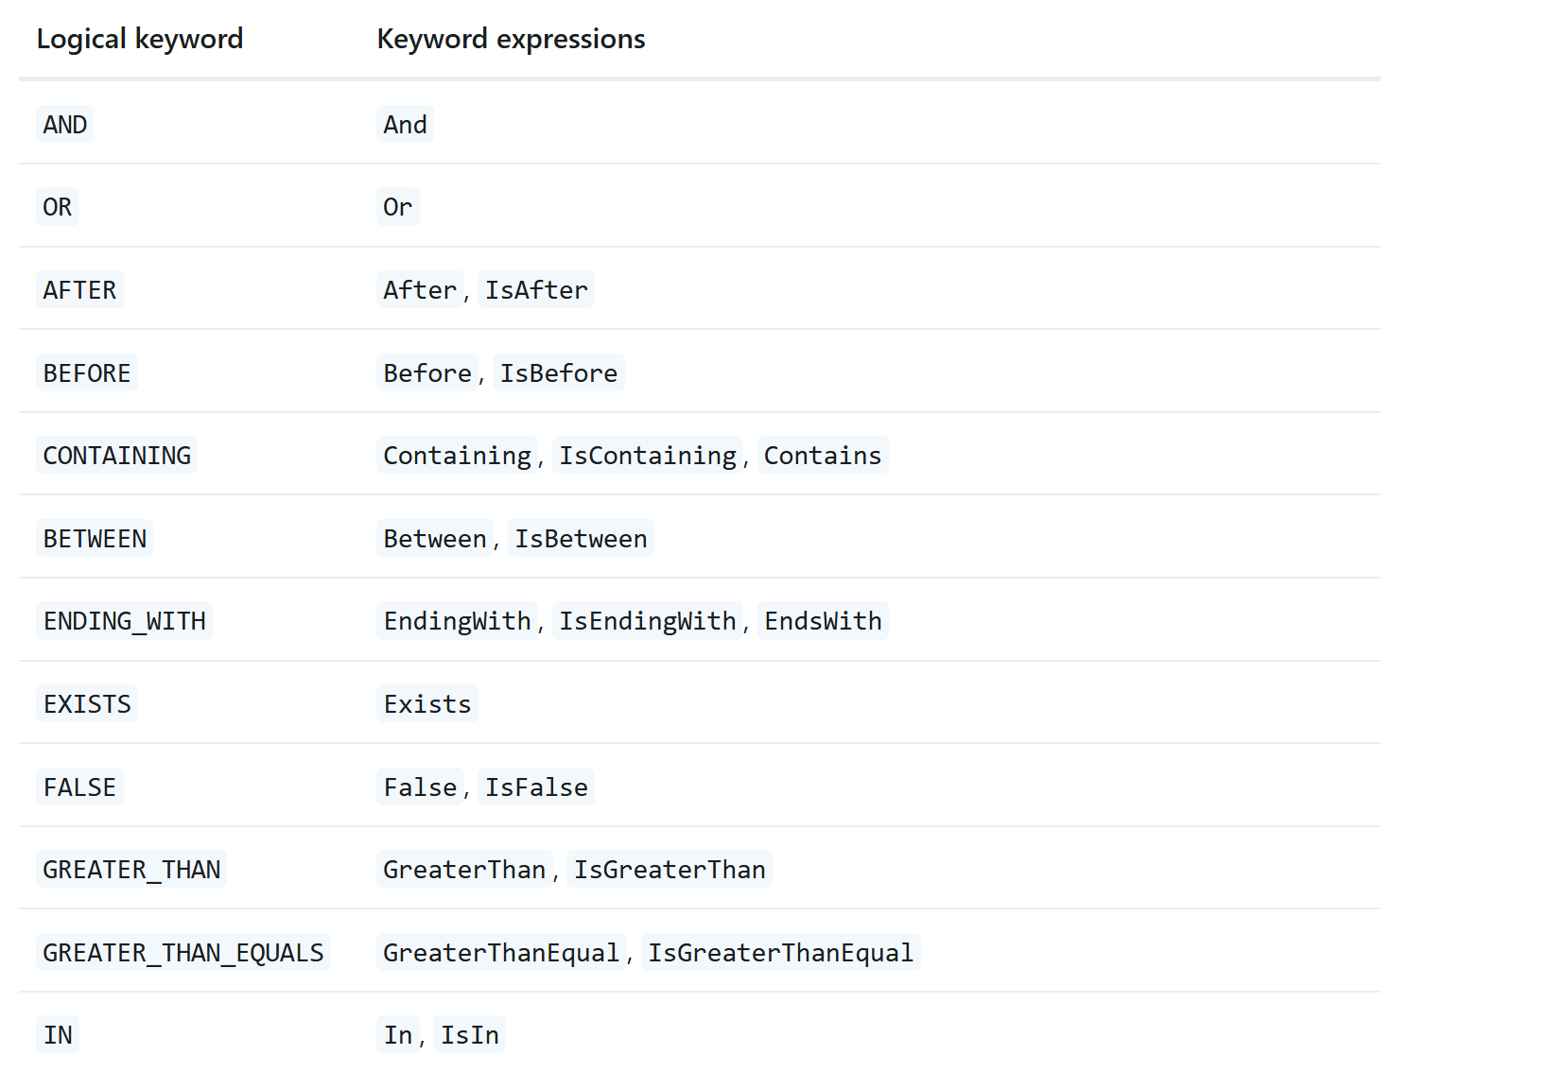
Supported query method predicate keywords and modifiers
https://docs.spring.io/spring-data/jpa/reference/repositories/query-keywords-reference.html

Slide 19
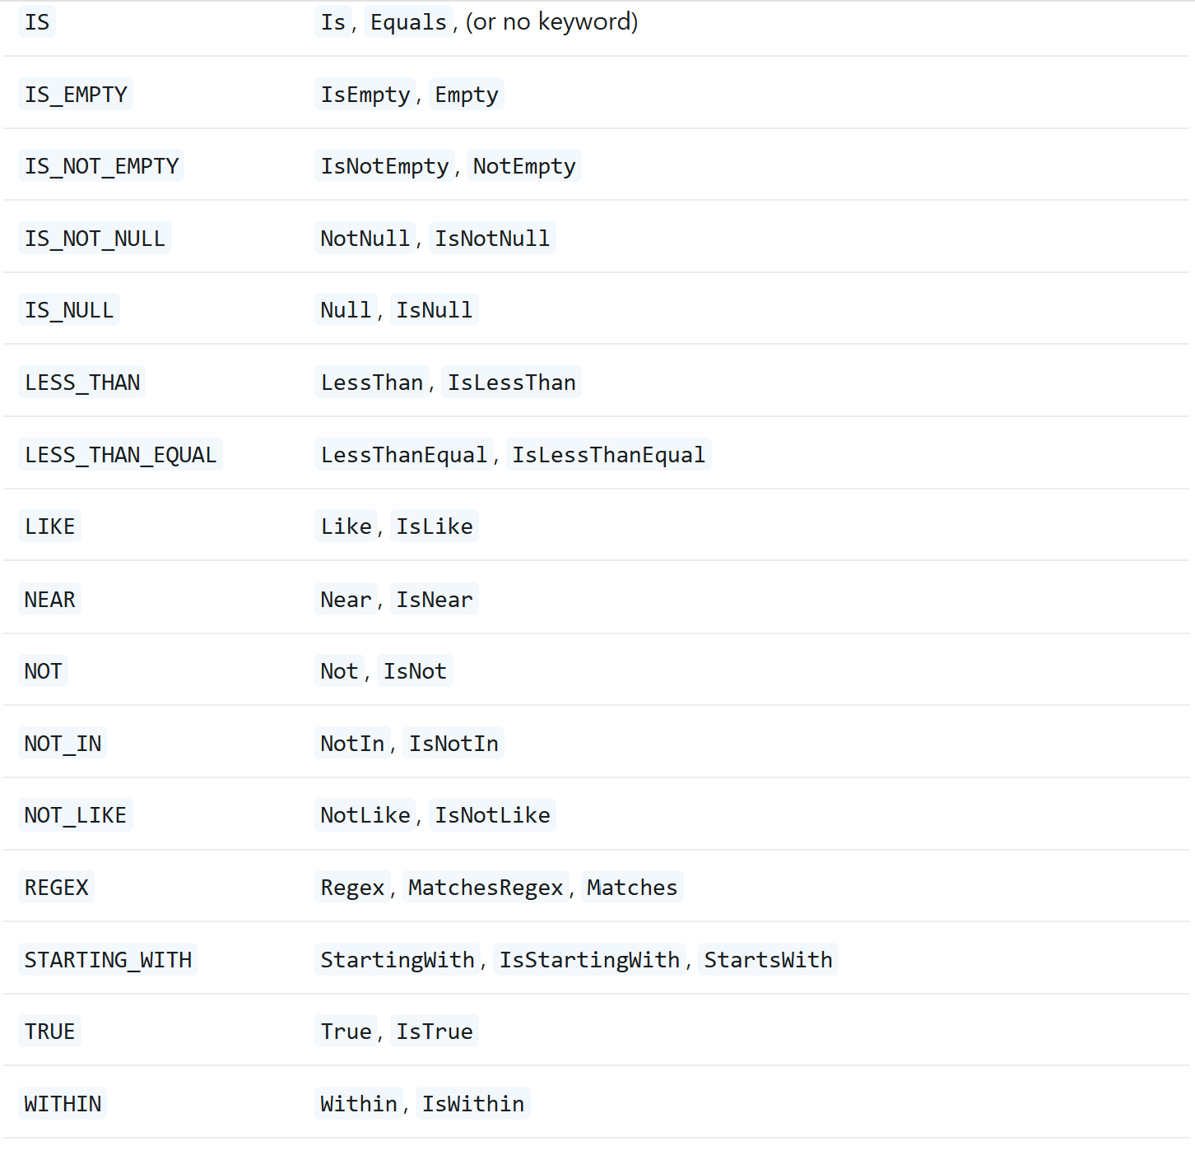
Supported query method predicate keywords and modifiers
https://docs.spring.io/spring-data/jpa/reference/repositories/query-keywords-reference.html

Slide 20
Spring Data JPA Programming Demo (ManyToMany)

Slide 21
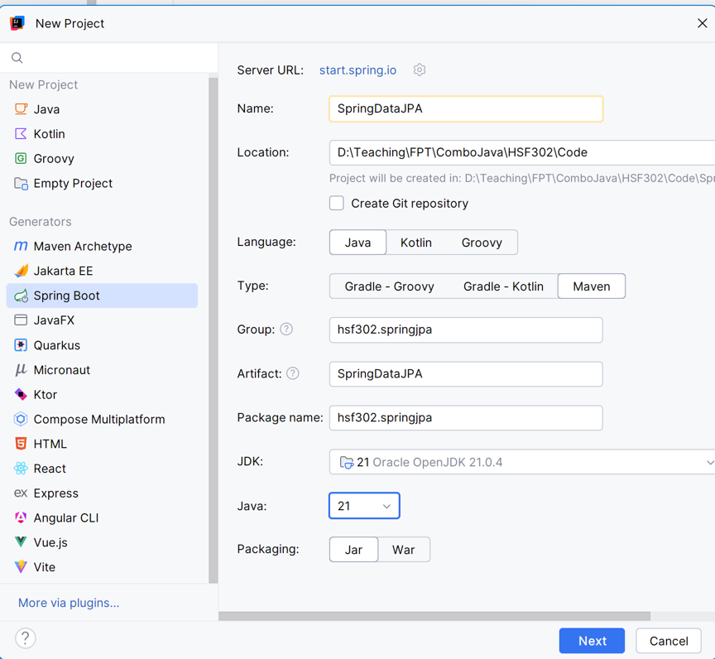
Open IntelliJ, File | New | Spring Boot -> Maven Project

Slide 22
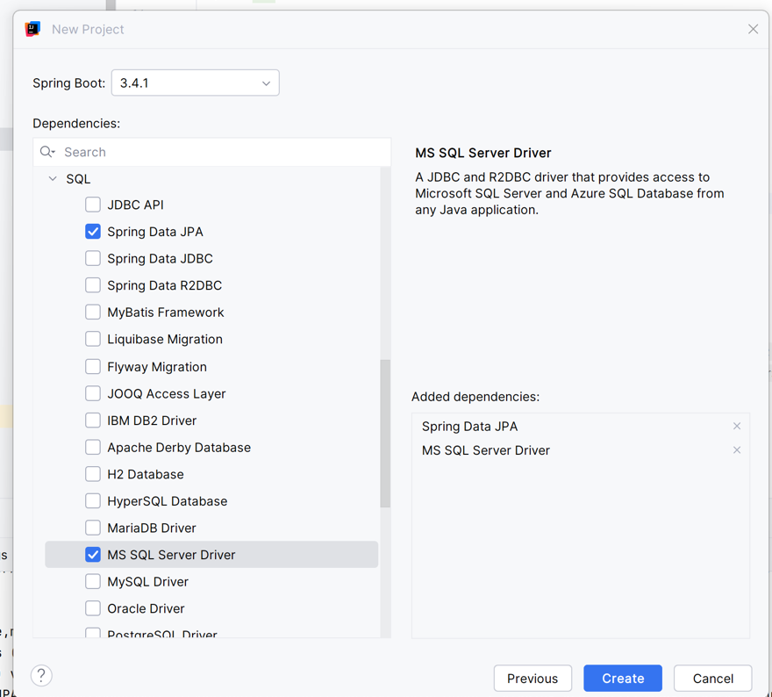
Add Dependencies

Slide 23
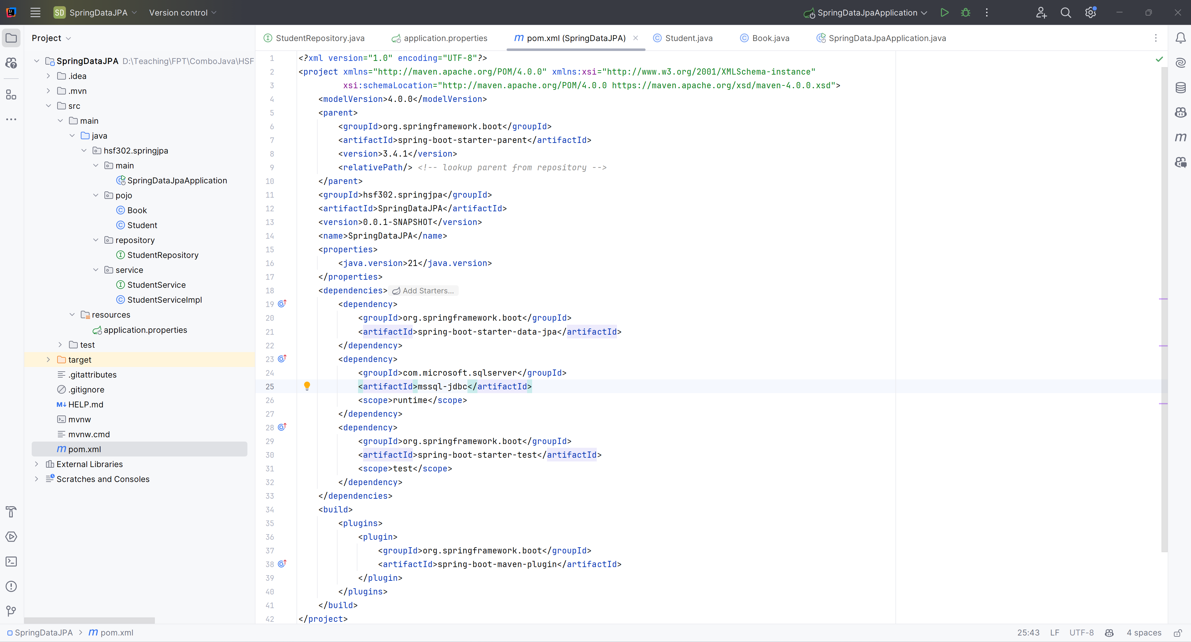
Create the Structure Project

Slide 24
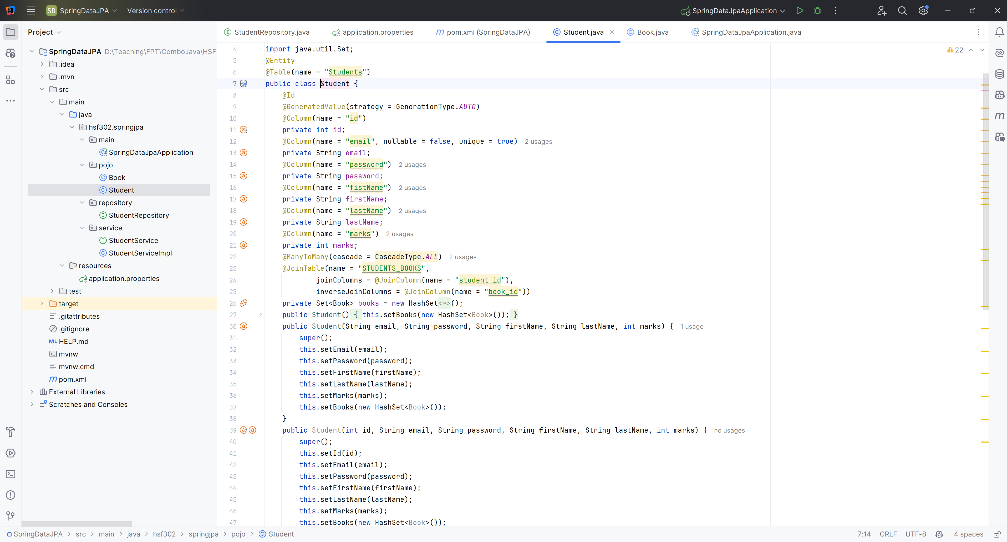
Create the Student.java in pojo

Slide 25
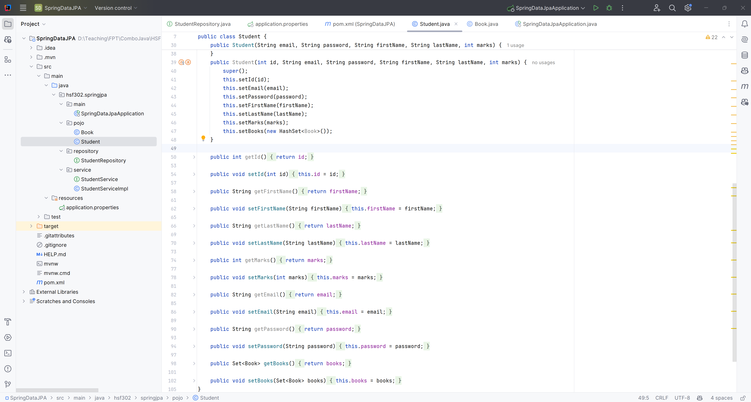
Create the Student.java in pojo

Slide 26
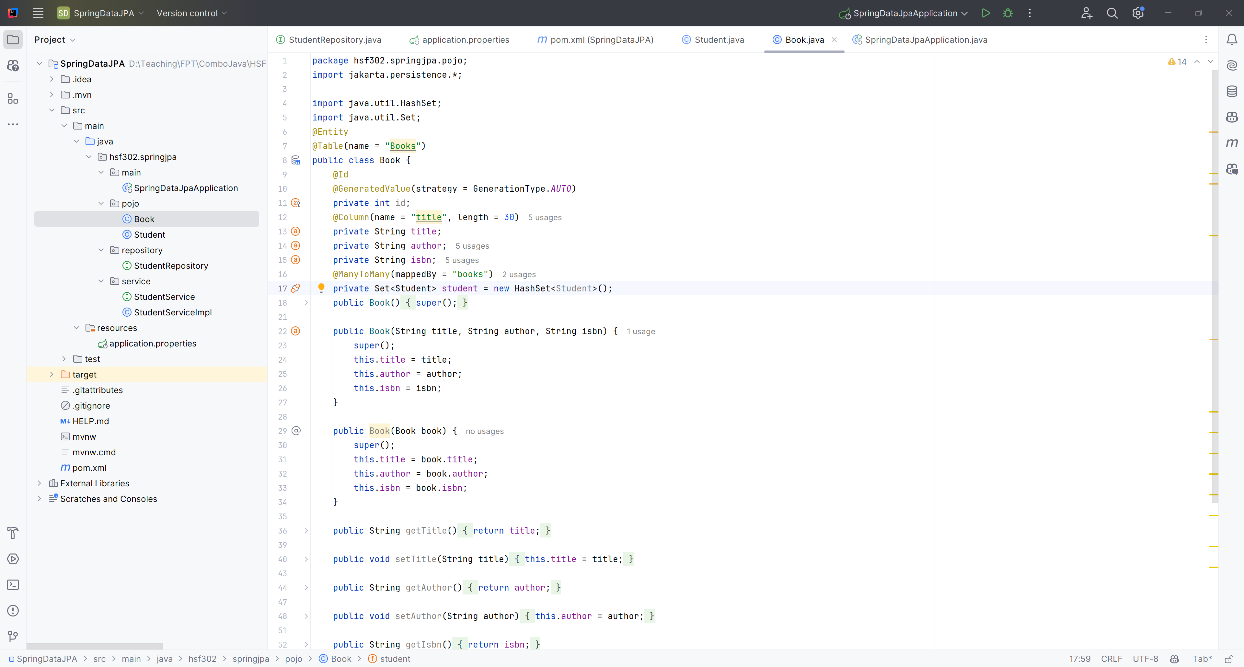
Create the Book.java in pojo

Slide 27
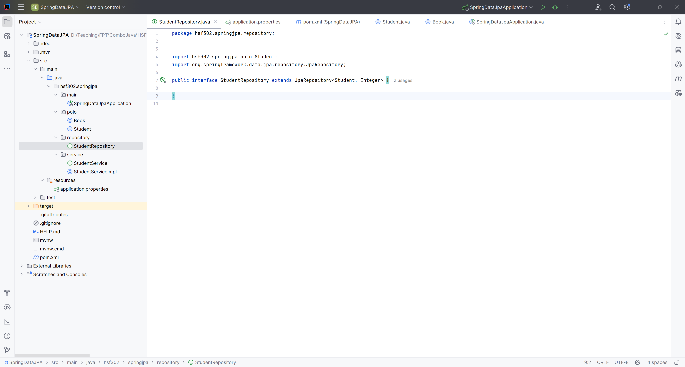
Create the StudentRepository.java in repository package

Slide 28
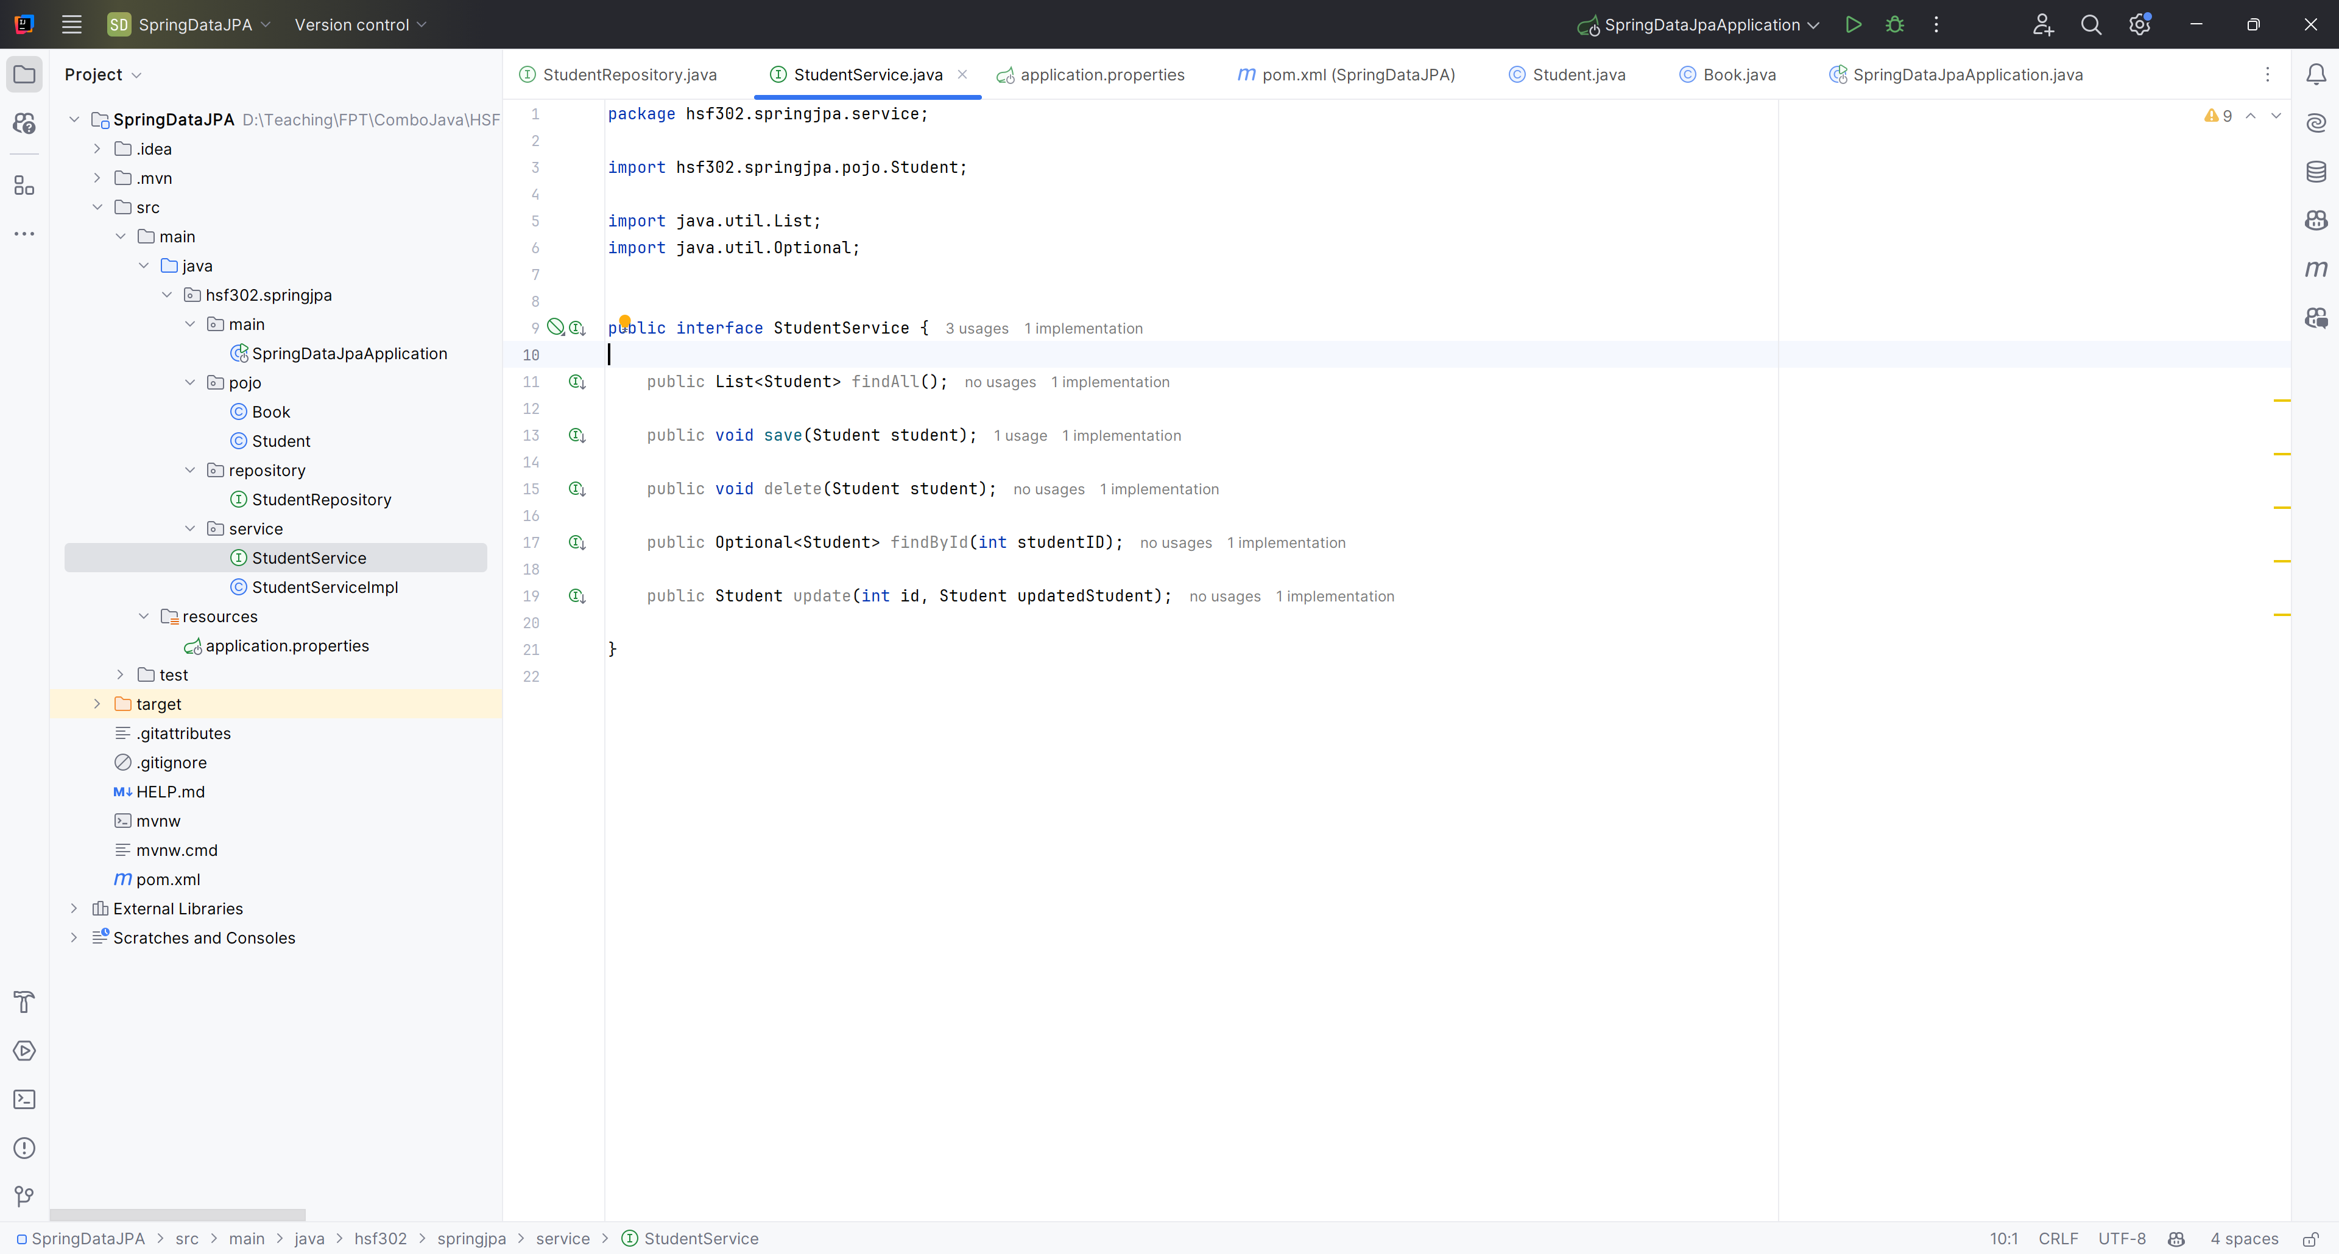
Create the StudentService.java in services package

Slide 29
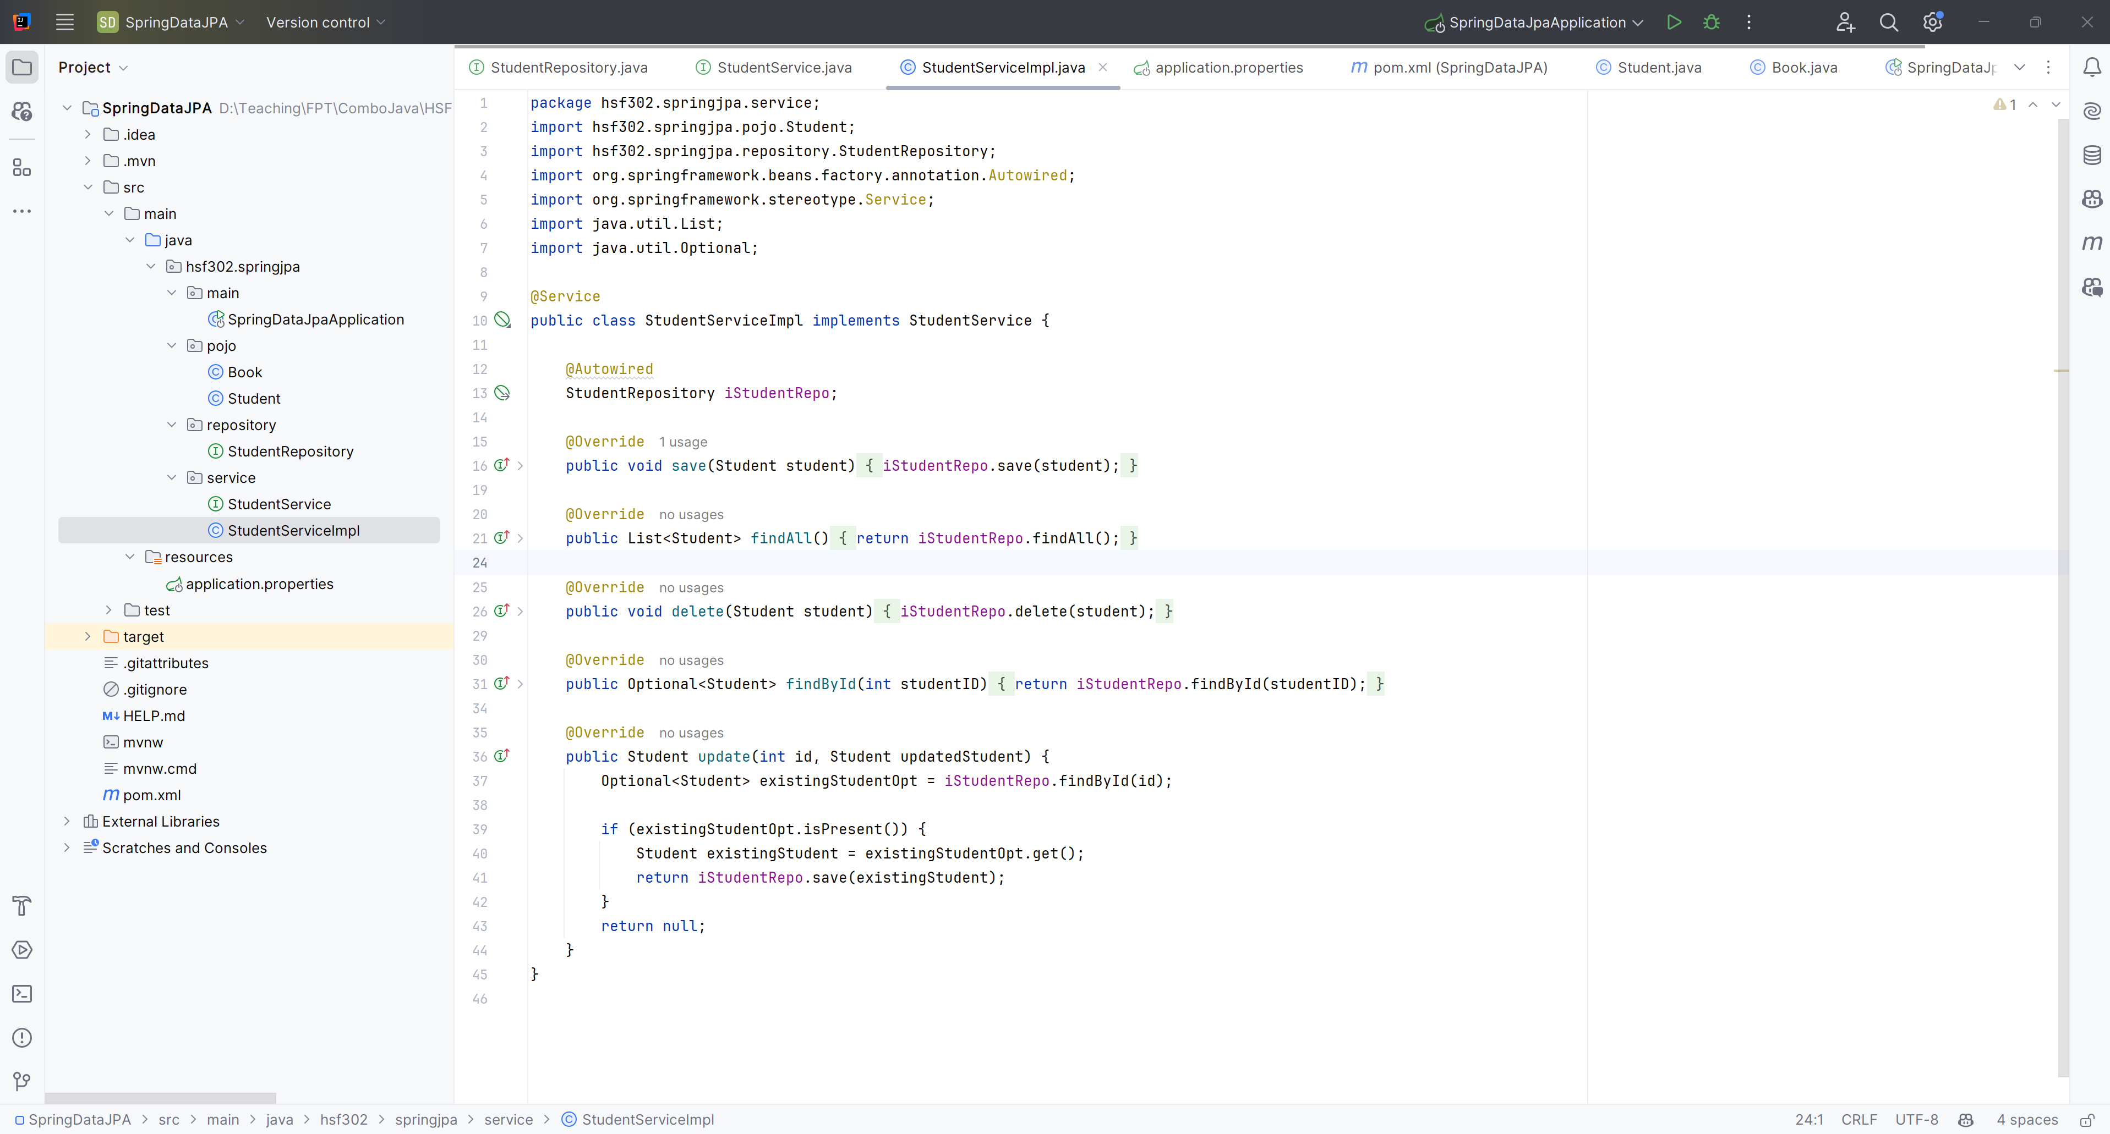
Create the StudentServiceImpl.java in services package

Slide 30
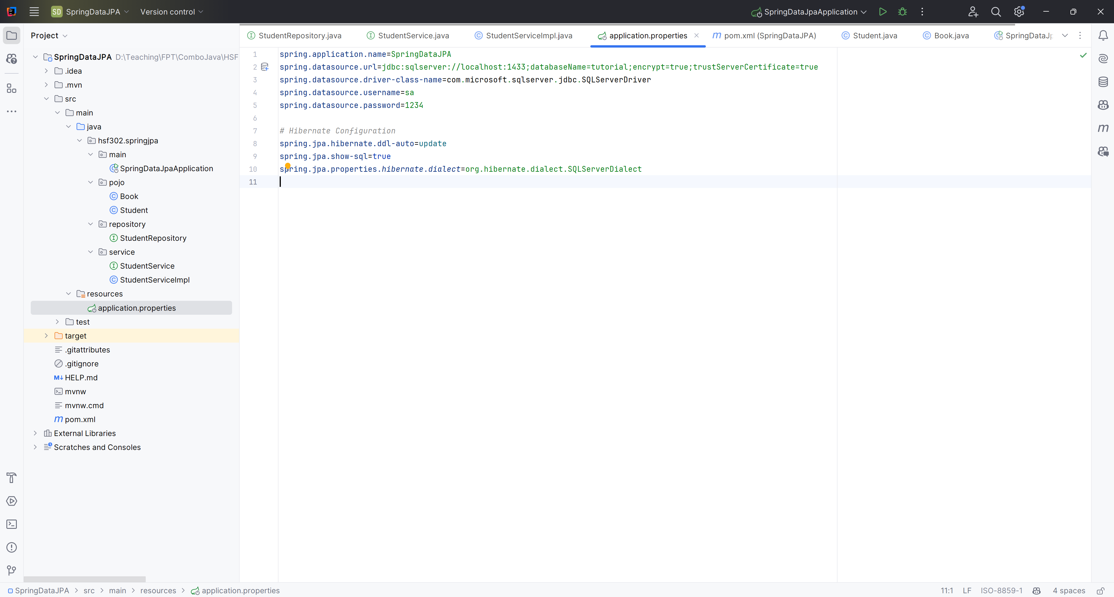
Create the application.properties in resources

Slide 31
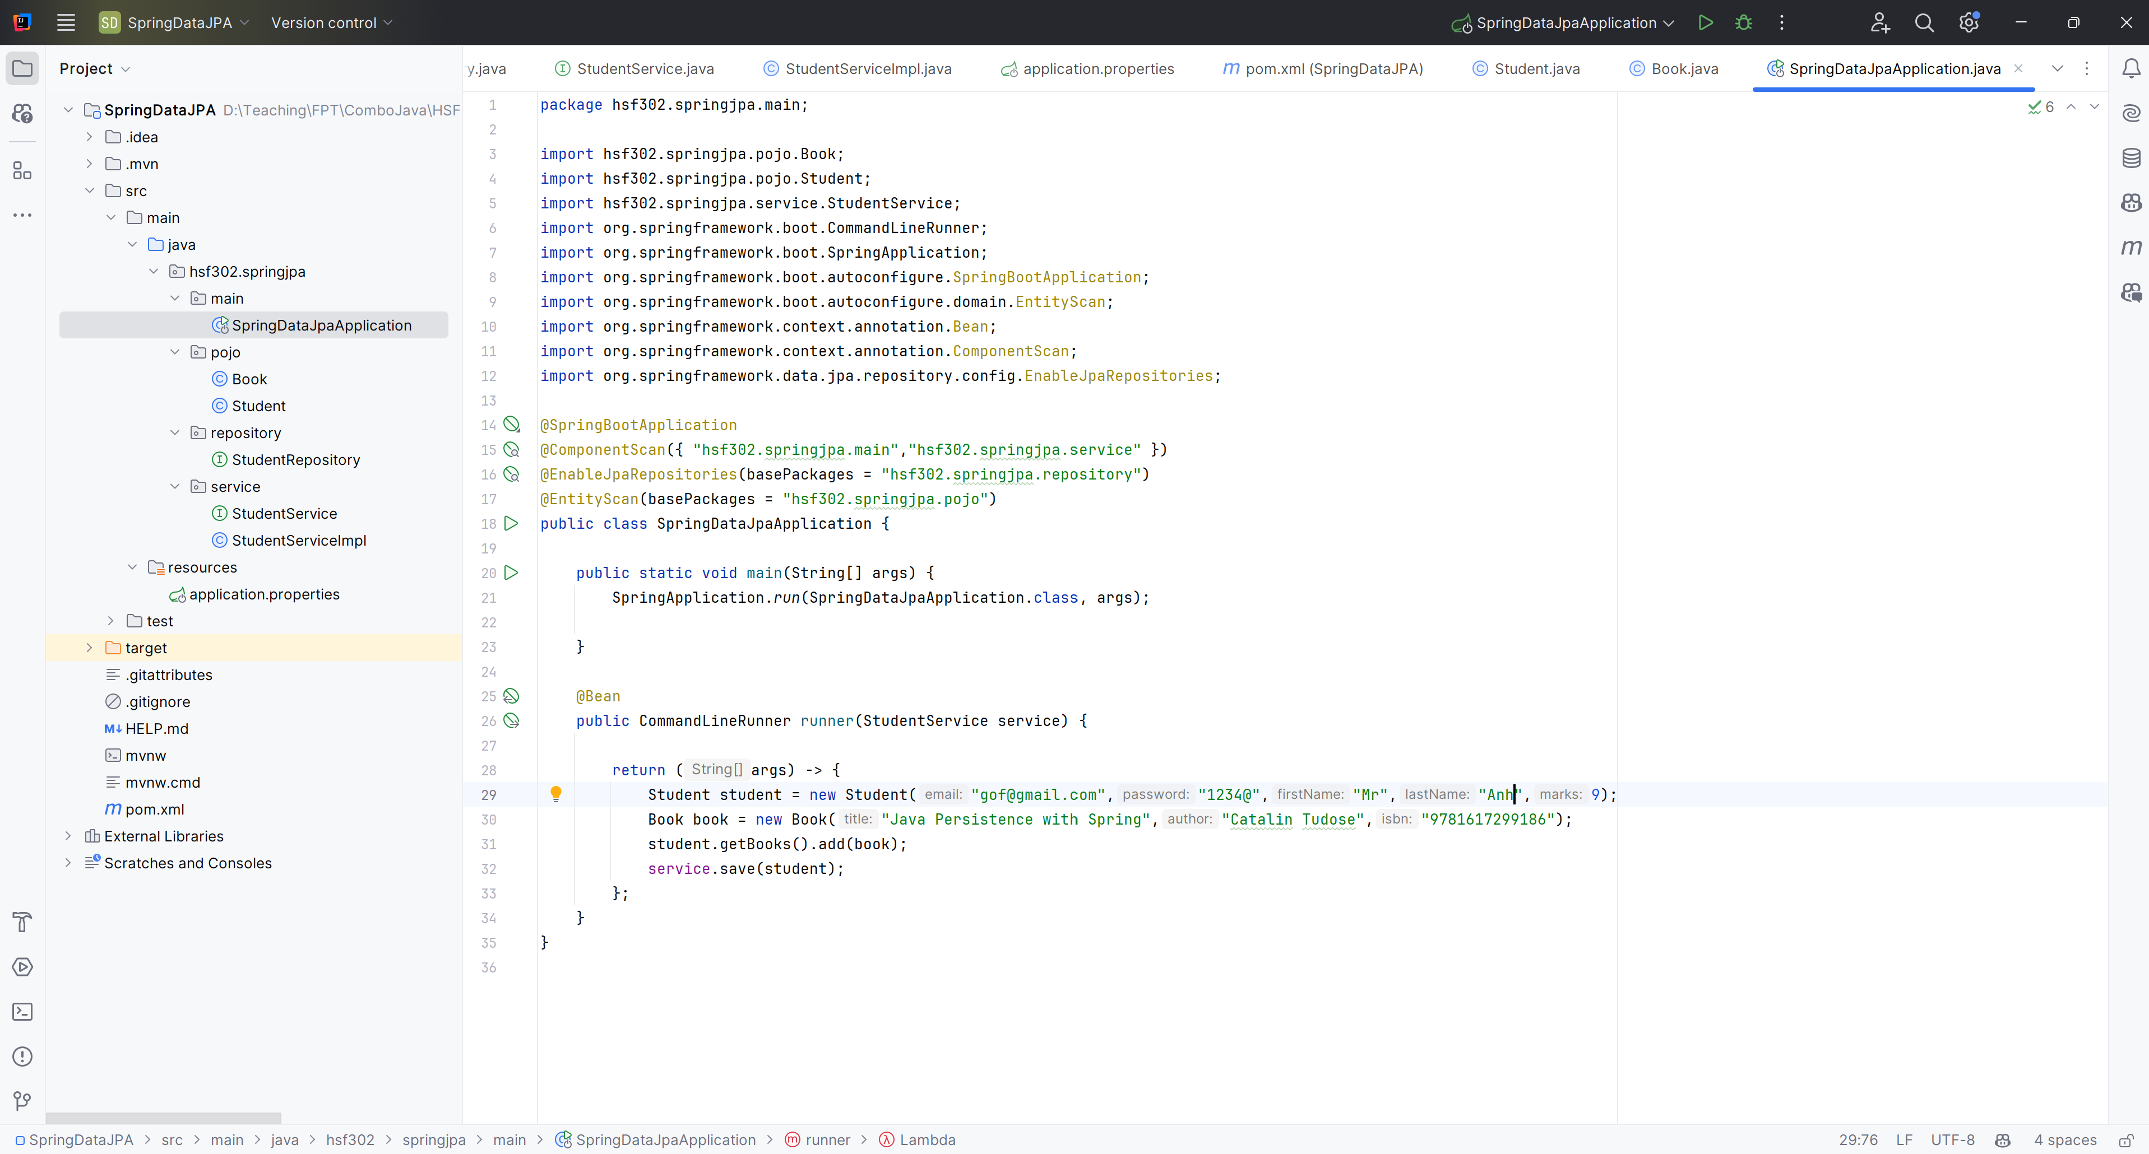
Edit main function

Slide 32
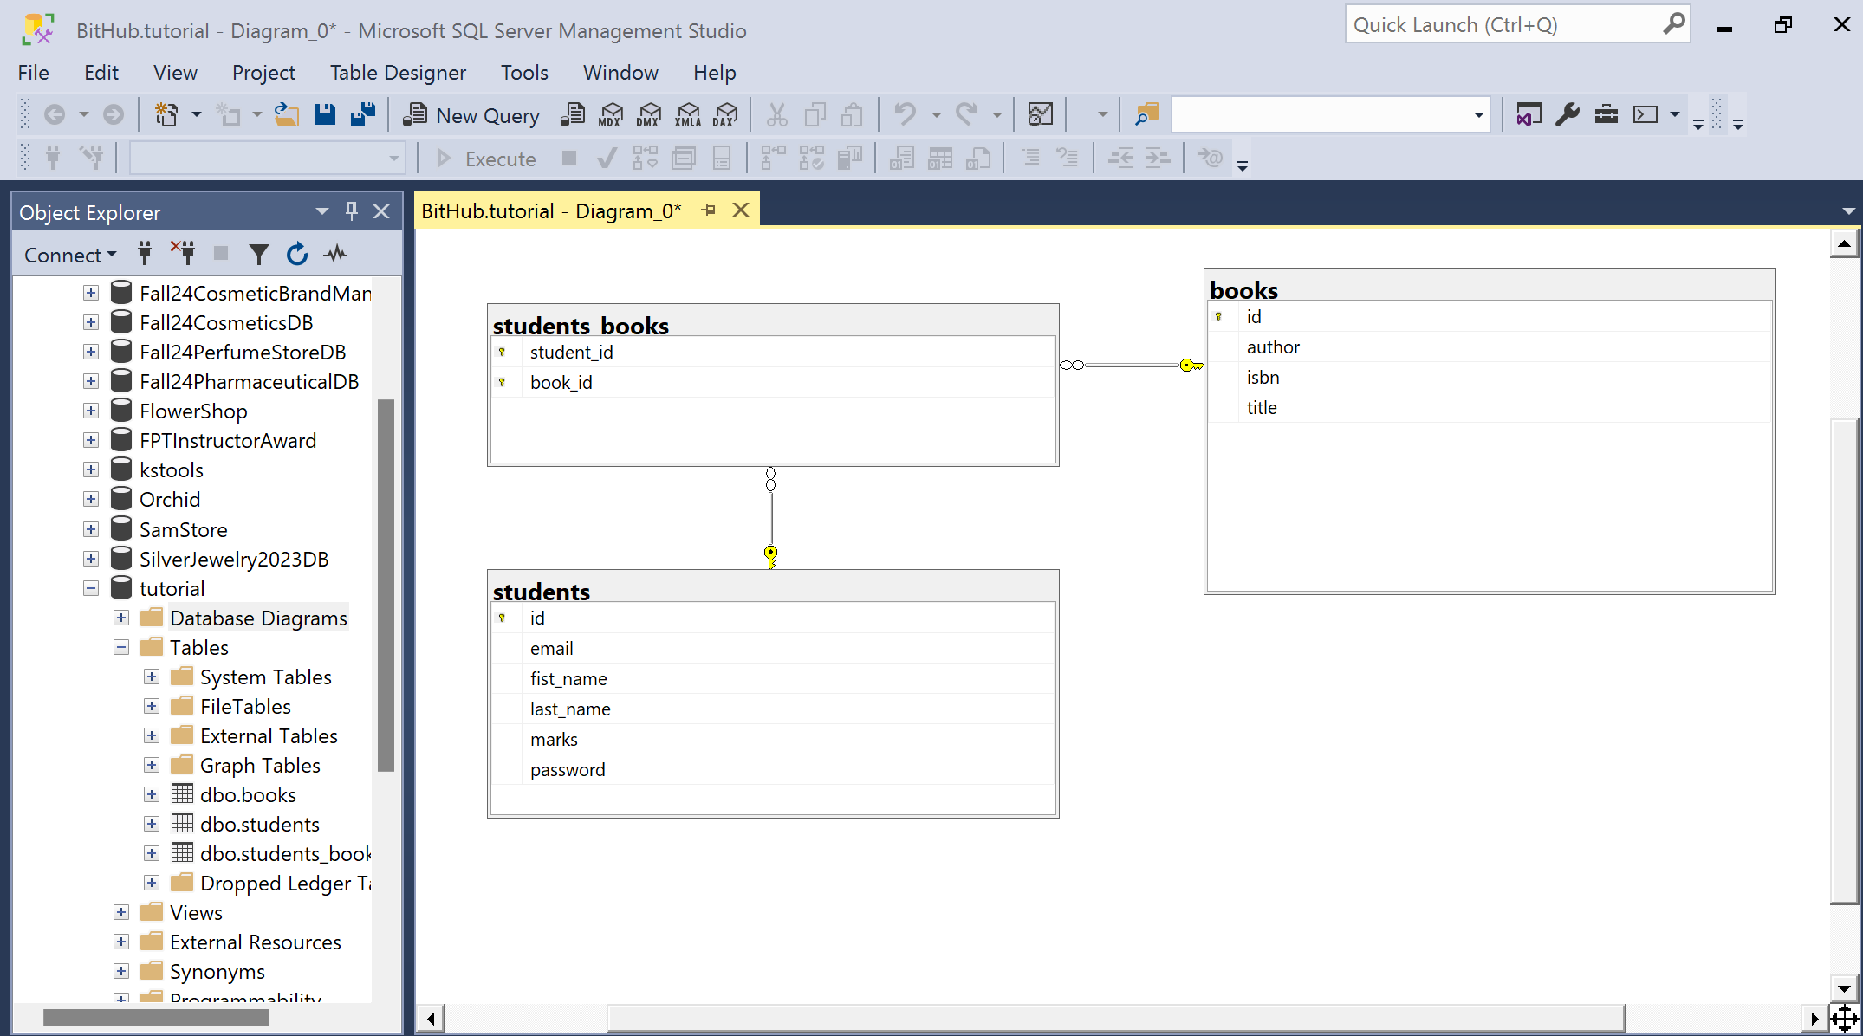
Run Program

Slide 33
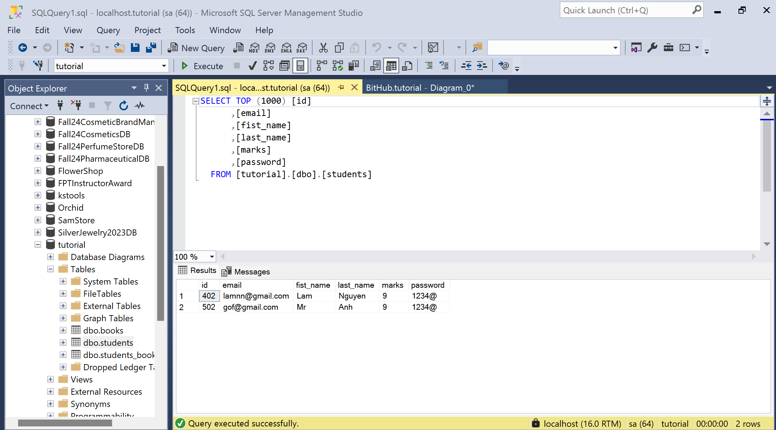
Result student table

Slide 34
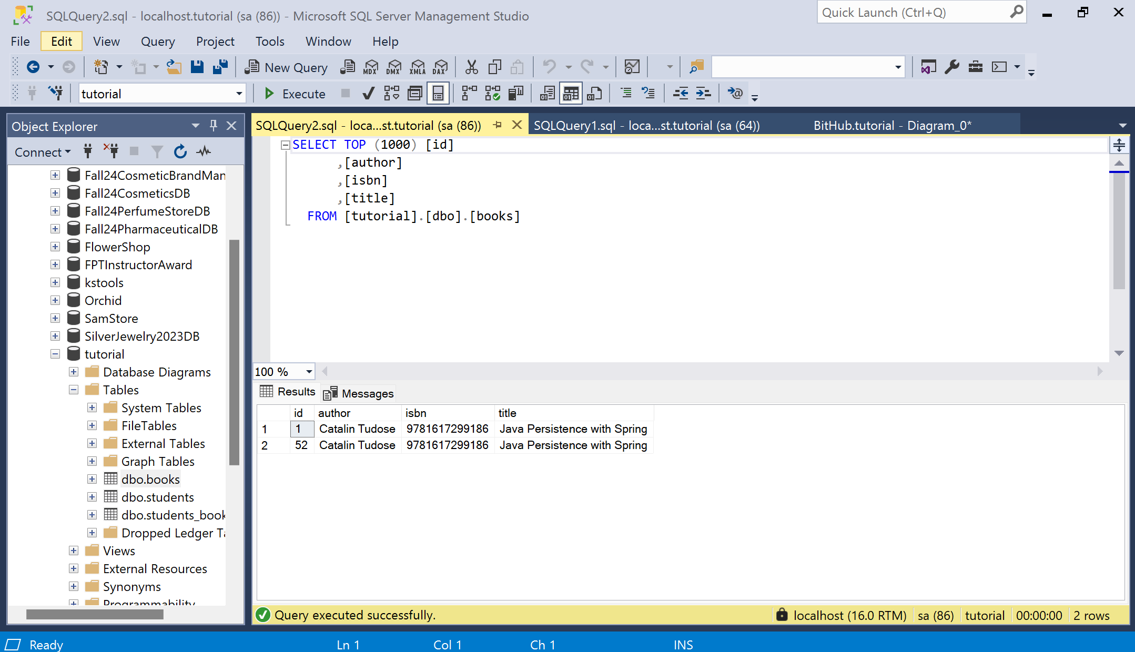
Result book table

Slide 35
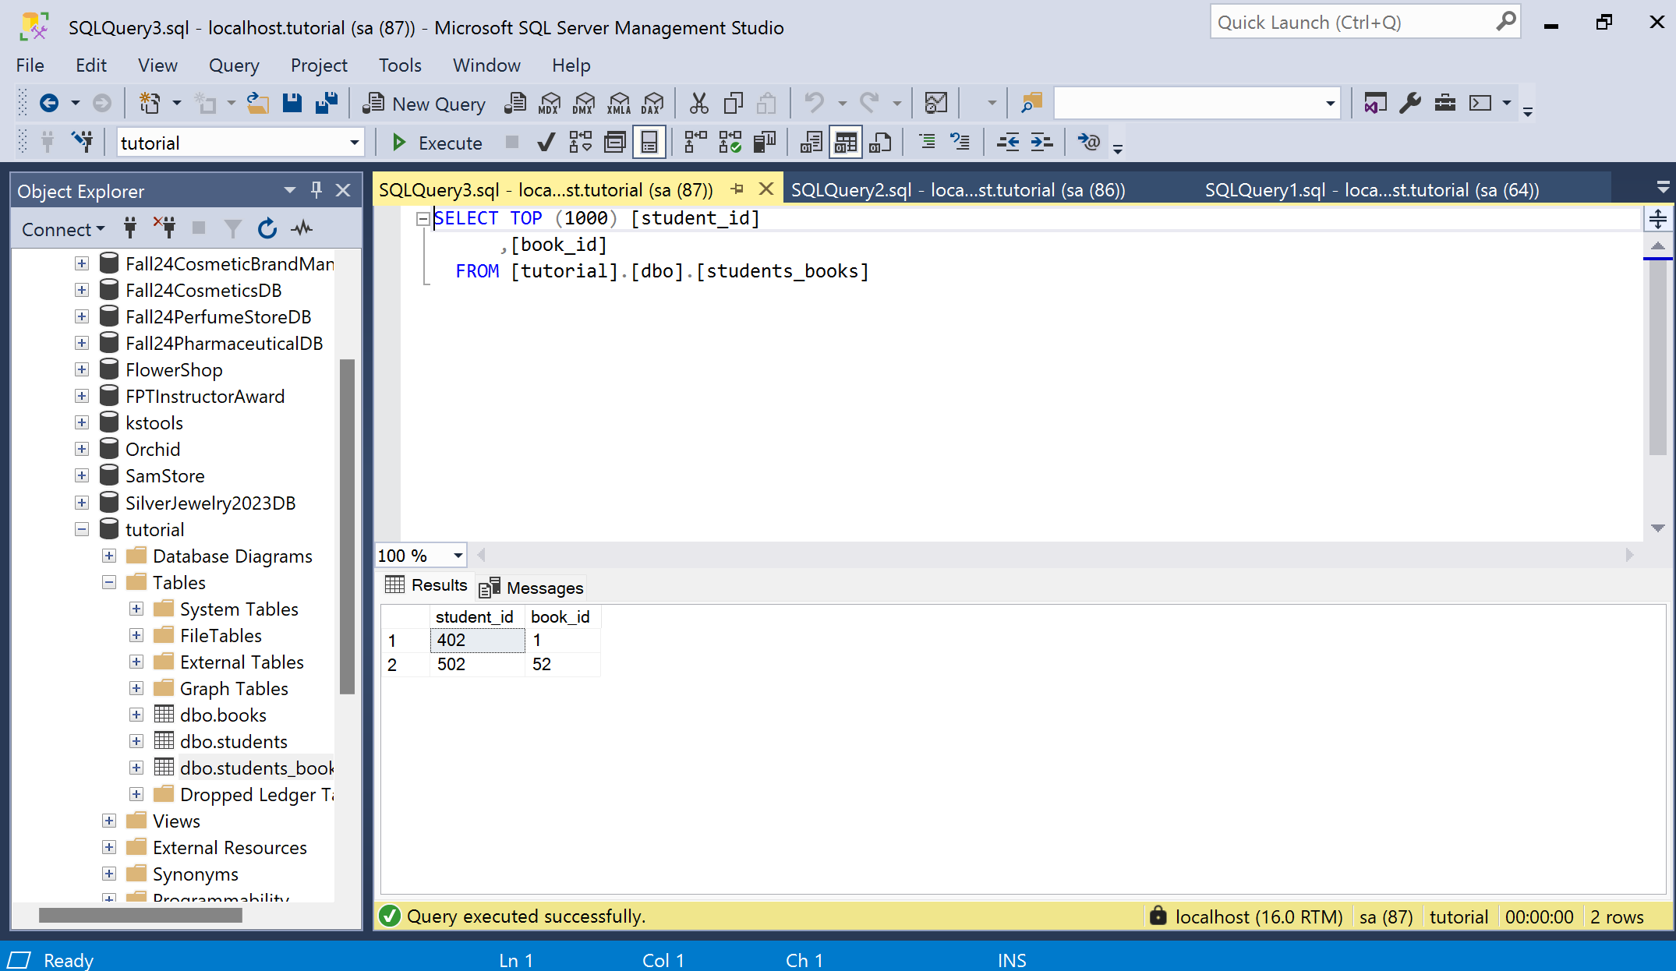
Result student-book table

Slide 36
Summary
Concepts were introduced:
Spring Data JPA
Advantages of using Spring Data JPA
Key features of Spring Data JPA
Dependency Injection and Inversion of Control
N-Layer

